Slide 1
Direct QR Factorization for tall-and-skinny matrices in MapReduce architectures
By Group XXL

Slide 2
What is tall-and-skinny matirces?
Matrix A: m×n, m>>n

Slide 3

What is QR factorization?
A=Q∙R
Orthogonal
Upper triangular
A is an m x n real-valued matrix.
Q is an m x n orthogonal matrix.
R is an n x n upper triangular matrix.

Slide 4

What is QR factorization used for?
Assume we have system AX = b.
Then we want to find x* that would yield:

Slide 5
The algorithms in this paper.
Indirect QR factorization
Cholesky QR
Indirect TSQR (Tall & Skinny)
Pseudo-Iterative Refinement
Direct TSQR factorization

Slide 6
Cholesky QR
The Cholesky factorization of an n x n symmetric
positive definite real-valued matrix A is:
A = LL^{T}
By following derivation, computing matrix R becomes computing A^{T}A.

Slide 7
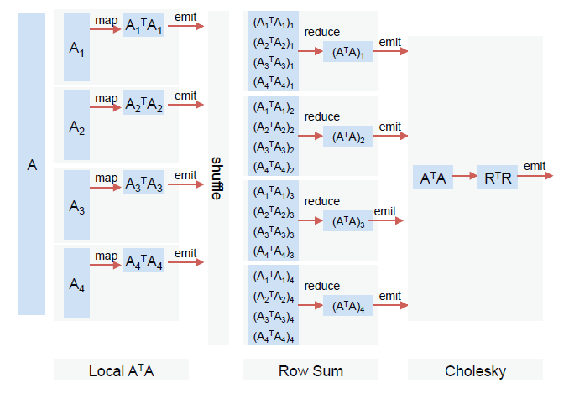
In MapReduce

Slide 8
Indirect TSQR
The communication-avoiding TSQR algorithm, which is known
to be numerically stable and was recently shown to have
superior stability to many standard algorithms.

Slide 9
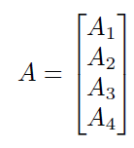
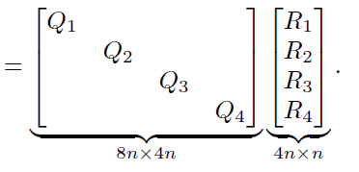
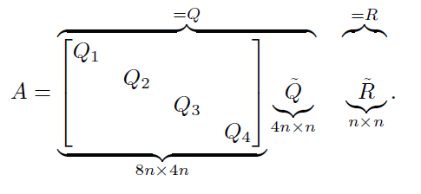
A_{i} = Q_{i}×R_{i} can be computed in parallel. If we only need R, then we can throw out the Q factors.
Map task:
Reduce task:

Slide 10
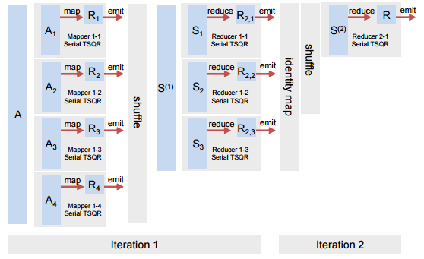
MapReduce with a 2-stage reduction tree.

Slide 11
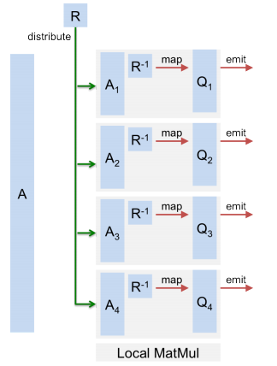
Computing Q = AR⁻¹

Slide 12
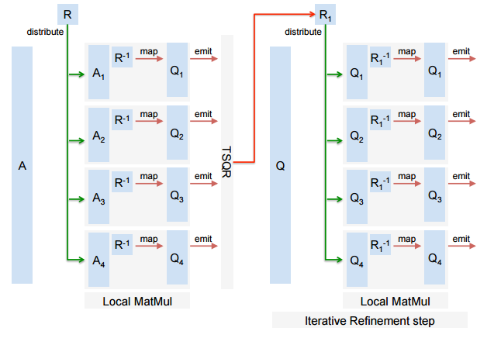
Iterative refinement: get Q within desired accuracy

Slide 13
Pseudo-Iterative Refinement
Key idea:
R factor from the QR factorization of a small, random subset of the rows of A is a first-order approximation to the R factor of the entire matrix.
Number of grows:
approximately 100*n*log(n)
Sampling matrix: A_{s}
A_{s} =>QR decomposition=> R_{s} (approximation to R)
Q₁(approximation to final Q)=> Q₁=AR_{s}⁻¹
=> R₁ (the R factor of Q₁)
Q(the refined Q factor)= Q₁R₁⁻¹
Thus R=R₁ R_{s}

Slide 14
Direct TSQR Factorization
3 steps:
Map, Reduce & Map
First Map:
Local QR decomposition
Input: A₁,A₂,A₃… Output: Q_{i,1} & R_{i} for each A_{i}
Second Reduce:
Single QR decomposition
Input: R₁,R₂,R₃… Output: Q_{i,2} & R(final)
Last Map:
Matrix multiplication
Input: Q from first step Output: Q(final)

Slide 15
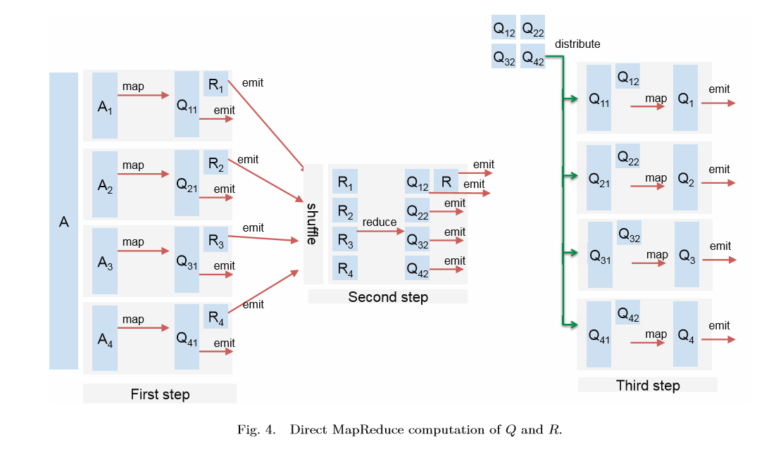
In MapReduce

Slide 16
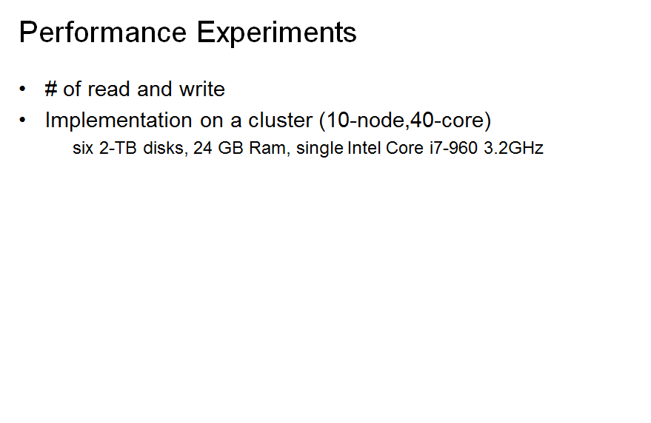
Performance Experiments

Slide 17
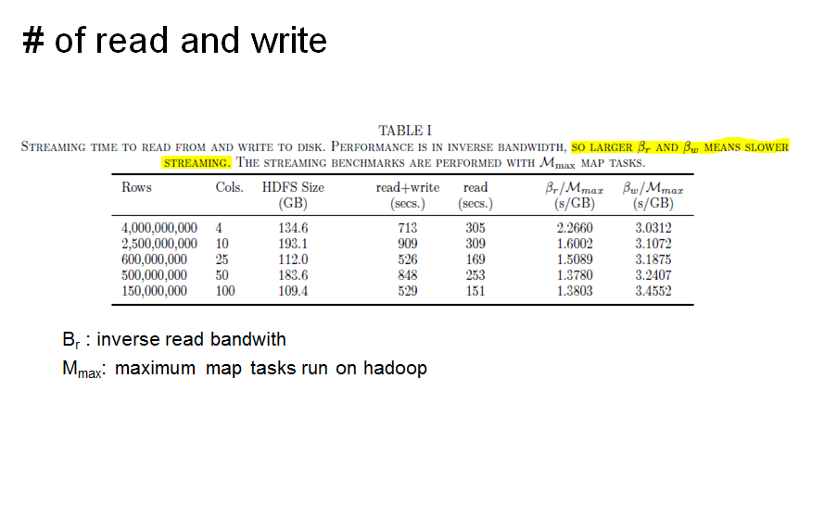

Slide 18
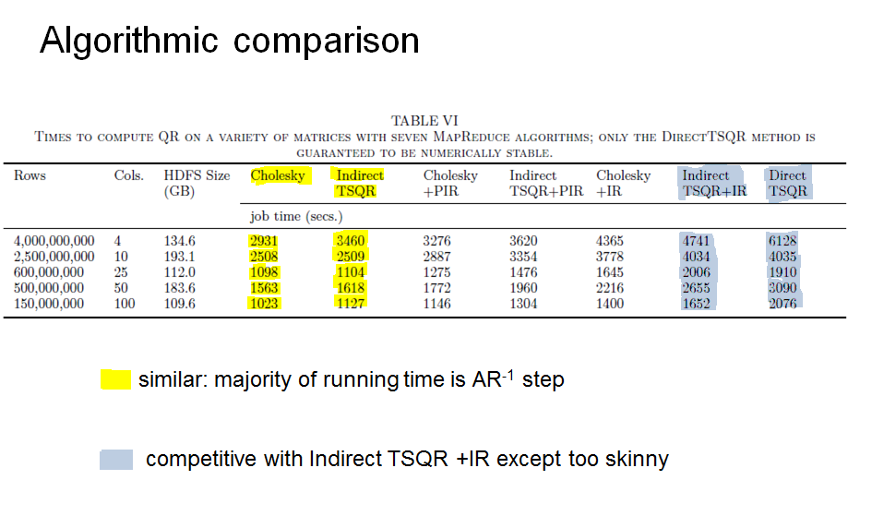

Slide 19
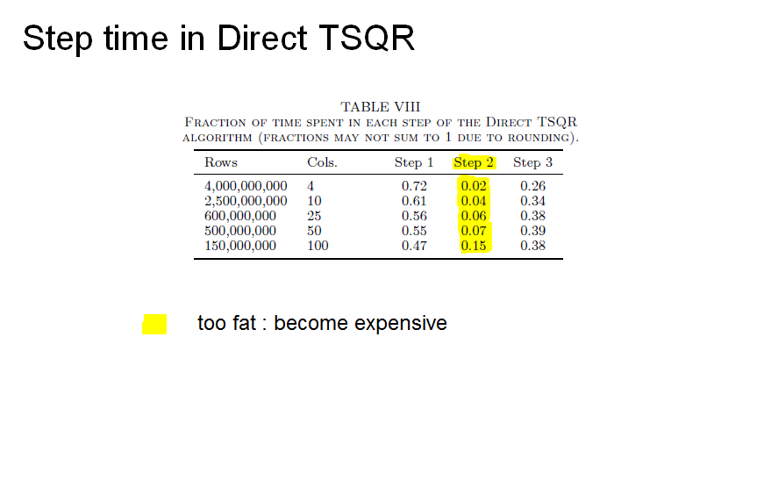

Slide 20
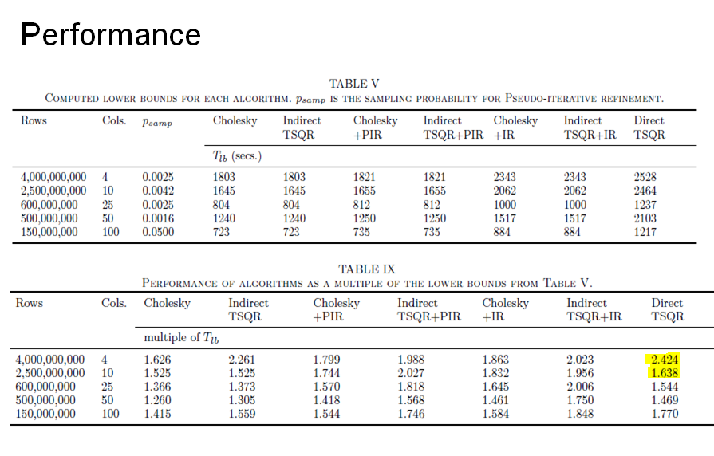

Slide 21
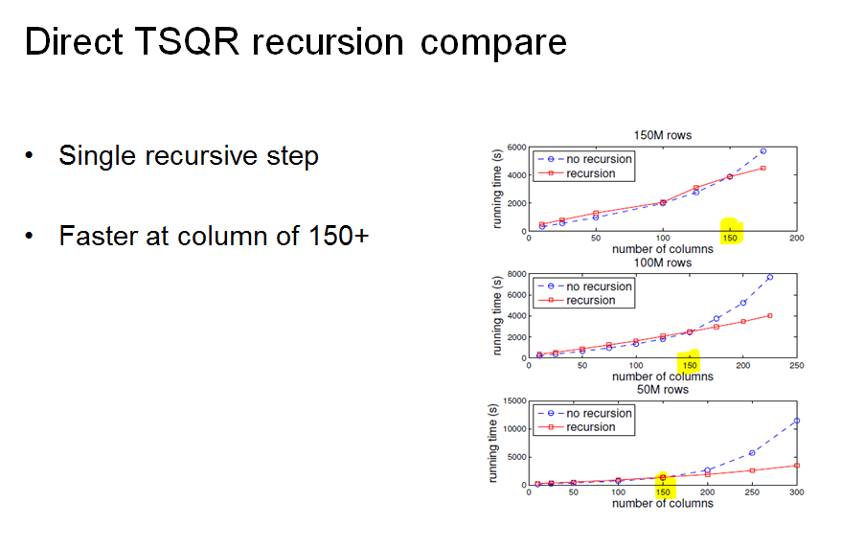

Slide 22
Conclusion
Prof
Guaranteed to produce a numerically orthogonal matrix
Cons
Takes about twice the time of the fastest
Unstable method

